Slide 1
LOCAL FOOD WASTE MANAGEMENT SYSTEM
Presented by JANSIRANI A
Batch Code: DS-S-WD-T-B50

Slide 2
INTRODUCTION
Problem: Every day, large amounts of edible food are wasted, while many people go hungry. There is no structured platform to connect food donors with those in need locally.
Solution: Platform to connect food providers (hotels, homes, stores) with receivers (NGOs, shelters).
Objective: The main goal is to reduce food waste by connecting food providers (restaurants, homes, supermarkets) with receivers (NGOs, shelters, or individuals in need).
Goal: Minimize waste, feed the needy.

Slide 3
PROJECT ARCHITECTURE
Component | Technology
Frontend | Python (Streamlit)
Backend | SQLite3 Database
Data Analysis | Pandas, Matplotlib, Seaborn
File Handling | CSV-based data sync
Deployment | Localhost / Streamlit Cloud

Slide 4
MODULES OVERVIEW
Homepage.py Dashboard for users to filter and view data
Providers.py Register and manage food donors
Receivers.py Register and manage people/organizations who need food
Food_listing_datas.py List surplus food with quantity and expiry
claim_status.py Receivers claim food, and admin updates status
Queries.py Charts and data insights using SQL queries
About.py Describes project goals and benefits

Slide 5
HOW IT WORKS
1. User Registration
Two types of users:
Providers (donate food)
Receivers (request/claim food)
Each user fills a registration form with details (Name, Type, City, Contact).
The data is saved in:
SQLite database (Local_food_WM.db)
CSV backup files
2. Provider Lists Surplus Food
Provider logs in and opens the Food Listing page.
Fills a form with:
Food name, quantity, expiry date, food type (veg/non-veg), meal type (lunch, dinner).
System auto-generates a Food ID.
Listing gets saved in:
food listings table in database
food_listings_data.csv file
3. Receiver Browses Food Listings
Receiver opens the dashboard or homepage.
Views available food based on:
Location
Meal Type
Food Type
Chooses suitable food and proceeds to claim.
4. Claiming Food
On the Claim Status page:
Receiver selects Food ID and Receiver ID.
Submits the claim → System assigns Claim ID and sets status to “Pending”.
Claim info is stored in:
claims table in database
claims_data.csv for backup

Slide 6
HOW IT WORKS
5. Admin Updates Claim Status
Admin views all Pending claims.
From the dropdown, selects a Claim ID.
Can:
✅ Mark as Completed
❌ Mark as Cancelled
Updates are synced to both DB and CSV.
6. View Reports and Insights
Go to the Queries page.
Choose from 25+ SQL-based questions like:
“Which city has the most donations?”
“Which meal type is most claimed?”
See visual charts generated using:
Matplotlib, Seaborn
7. All Data is Synced
Every action (registering, listing, claiming) updates:
SQLite database (main source)
CSV files (backup, easy to export)

Slide 7
HOMEPAGE (HOMEPAGE.PY)
Purpose: Acts as the main dashboard for viewing and filtering data from all key tables.
Features:
Let’s users select from tables: Providers, Receivers, Food Listings, or Claim Status.
Dynamic filtering by city, type, ID, meal type, etc.
Displays clean tables from SQLite DB.
Example Use:
A user selects “Food Listings” → filters by city = Chennai and meal type = Lunch → sees all relevant entries.

Slide 8
PROVIDERS MODULE (PROVIDERS.PY)
Purpose: Handles registration, viewing, updating, and deleting of food providers.
Who is a provider?
Restaurants, supermarkets, grocery shops, catering services who donate surplus food.
Features:
Provider registration form: Name, Type, Address, City, Contact (unique)
CSV and SQLite DB storage
Update/Delete functionality
Displays latest provider registered
Example Use:
A restaurant registers as a provider → lists its details → ready to donate food.

Slide 9
RECEIVERS MODULE (RECEIVERS.PY)
Purpose: Manages registration, updating, and deletion of receivers.
Who is a receiver?
Individuals, NGOs, shelters, or charities that need food.
Features:
Receiver form: Name, Type (NGO, individual), City, Contact.
Prevents duplicate contact entries
Lists all registered receivers
Update/Delete options
Example Use:
An NGO registers → can now view and claim food listings.

Slide 10
FOOD LISTINGS (FOOD_LISTING_DATAS.PY)
Purpose: Providers use this to list surplus food for donation.
Features:
Form to list food with: Name, Quantity, Expiry Date, Type (Veg/Non-Veg), Meal (Breakfast/Lunch/etc.)
Auto assigns Food ID
Connects listing to Provider ID
Edit or Delete listed food
Recently added listing is shown
Example Use:
Supermarket lists “5 packs of bread” that expire today → added to live listing.

Slide 11
CLAIM STATUS (CLAIM_STATUS.PY)
Purpose: Receivers can claim food, and admin can track or update claim status.
Features:
Displays all claim records
Form for receivers to claim food by selecting Food ID and Receiver ID
Admin panel: Mark claim as “Completed” or “Cancelled”
Syncs with both CSV and DB
Shows latest claims submitted
Example Use:
An NGO claims “10 lunch meals” → status is “Pending” → admin marks it as “Completed” after delivery.

Slide 12
QUERY & INSIGHTS (QUERIES.PY)
Purpose: Provides analytics & visual insights using SQL and charts.
Features:
25+ SQL queries with dropdown selection
Dynamic filters (e.g., city selection)
Visuals using Seaborn and Matplotlib (bar charts, line graphs)
Reports trends: food demand, top donors, most claimed items, etc.
Allows data export to CSV
Example Use:
Admin runs a query → sees that “Lunch” is the most claimed meal type → shares this for awareness.

Slide 13
ABOUT PAGE (ABOUT.PY)
Purpose: Explains the goal and benefits of the project to end-users.
Features:
Introduction to the problem of food waste
Steps on how the system works
Social and environmental benefits
Clean UI with markdown and emojis
Example Use:
A first-time visitor lands on this page → understands the mission → encouraged to register.

Slide 14
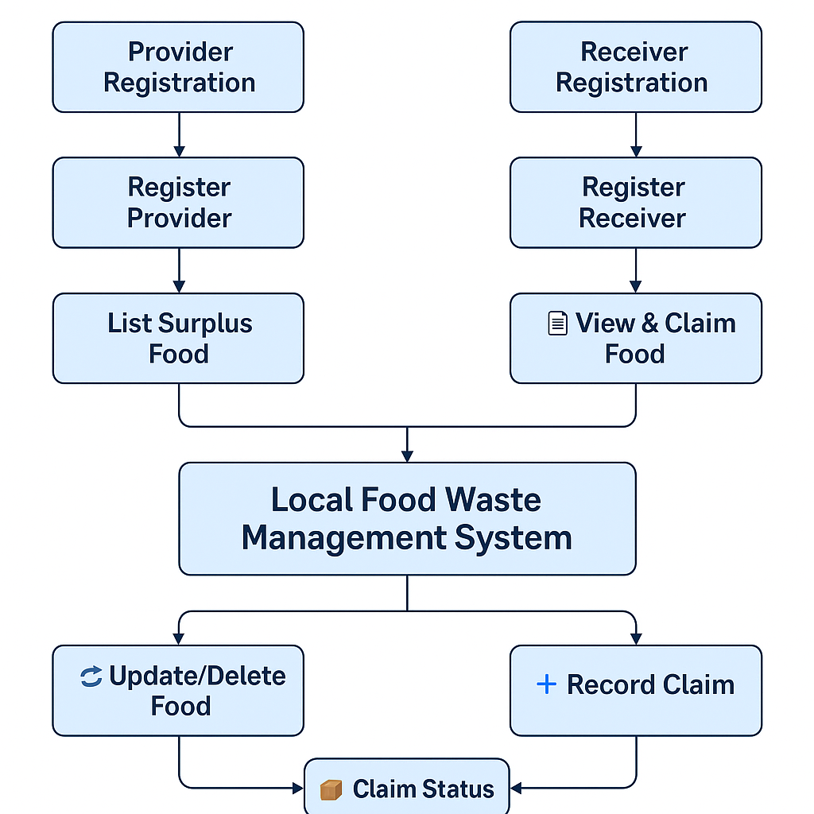
DATA FLOW DIAGRAM

Slide 15
BENEFITS
Reduces local food waste
Helps feed hungry communities
Promotes sustainability
Encourages social responsibility

Slide 16
FUTURE SCOPE
Mobile app for wider access
Real-time location tracking for food pickup
WhatsApp/SMS alerts
Delivery staff integration

Slide 17
CONCLUSION
This project is a practical and scalable tech solution to reduce food waste and support the underprivileged. It enables real-time donation and tracking for social impact.

Slide 18
THANK YOU…

